Slide 1
Clarifying Quality Control
56th Illinois Bituminous Paving Conference
Bill Pine, Heritage Construction & Materials
Notes:
Good afternoon – I’m glad to be here and appreciate the opportunity to speak today.
As you can see, my presentation is entitled CLARIFYING Quality Control.
QC is a subject that I’m involved with pretty much every day and one that I’m passionate about.
Most folks think of mix testing when the subject of QC comes up.
And it seems we are doing more and more mix testing, for a host of reasons.
Unfortunately, that can significantly impact our ability to perform tasks that better fit the definition of quality control.

Slide 2
Defining Quality Control
“Inspection, analysis, and action applied to a portion of the product in a manufacturing operation to estimate overall quality of the product and determine what, if any, changes must be made to achieve or maintain the required level of quality.”
McGraw-Hill Dictionary of Science and Engineering
Notes:
Many years ago, I purchased a copy of the McGraw-Hill Dictionary of Science and Engineering.
This is the definition it provides for QC.

Slide 3
Defining Process Control
“Activities involved in ensuring a process is predictable, stable, and consistently operating at the target level of performance with only normal variation.”
BusinessDictionary.com
Notes:
Quality Control and Process Control are basically interchangeable in our business.
I obtained this definition for Process Control on-line at BusinessDictionary.com

Slide 4
How Do You Define QC?
It’s not just sample testing by QC personnel!
Everyone plays a role
  Quality Control
  Production
  Placement
Inspection
  Individual materials
  Mixture
  Processes
  Equipment
Analysis
  What’s wrong?
  What needs fixed?
Action
  Proactive vs. Reactive
Notes:
Through the inspection process, we determine the quality, or result, of a given test, and compare it to a “target”.
After the comparison is made, results that are outside acceptable limits from that “target” value, require analysis to determine why.
Once we determine what’s wrong, we can react to solve the problem.
There will always be unforeseen problems, but we must strive to be proactive in order to reduce the need to be reactive.

Slide 5
QC – Misperception
It’s not just mixture testing!
  Mix results may predict pay, but…
  For unacceptable results, what’s the next step?
Constantly testing mix samples, challenges us in performing actual “Quality Control”
Today, we are asking more of our QC personnel than ever before
Trained, staffed and equipped?
Notes:
Many people focus on mixture testing for making QC decisions.
Yes, mix results often determine, or predict, the pay (bonus or penalty) expected.
However, when something doesn’t fall within the required quality limits, the change needed to correct the issue relates to a point somewhere prior to determining the test result.
The number of mix samples seems to be increasing all the time, both from what the Owner requires and from what additional tests we are putting on QC personnel.
There’s only a limited amount of time for the QC personnel you have.
If they are constantly testing the mix, there simply isn’t enough time to look at all the other important aspects of Quality Control.
Are your QC personnel adequately trained?
Is your QC lab adequately staffed?
Is your QC lab adequately equipped?

Slide 6

QC Personnel
Must be:
  Trained
  Equipped
Over time they gain:
  Knowledge
  Experience
If managed correctly, they’ll become invaluable!
Notes:
All QC personnel must be trained and equipped.
Today’s evolving requirements make this an on-going process.
Over time, QC personnel gain valuable knowledge and experience.
Like any employee, they require oversight and management.
It helps immensely if that oversight and management comes from an individual that understands QC.
We all need constructive criticism from time to time.
But we also need encouraged.
Every employee needs to know they are valuable to their respective organization.
Which training philosophy does your organization have when it comes to investing in employees?

Slide 7
QC Personnel
Must be trained in numerous subjects:
  Materials properties
  Materials testing:
    Operation, calibration and maintenance of equipment
  Specification requirements
  Etc.
Must work closely with:
  Production & Placement personnel
  Requires knowledge of those operations
Notes:
QC personnel must be trained in numerous subjects, depending on what’s expected of them.
The basic subjects we typically think of are:
Materials properties
Materials testing, which requires knowledge of operating, calibrating and maintaining test equipment
Specification requirements
They also have to be able to work closely with Production and Placement personnel, which in turn requires some level of knowledge in regards to those respective operations.

Slide 8
QC Personnel
Sample (Stockpiles & Mix):
  Obtain, handle and test
    Do it accurately and consistently
    Do it at the “right” frequency
Manage materials
Understand the mix:
  Mix adjustments
  Impact on production and placement?
Snapshot of QC effectiveness
Recognizing segregated samples
Notes:
QC responsibilities typically focus on testing the individual materials and mix.
In most QC operations at plant mix facilities, we don’t test the liquid asphalt.
So we are generally testing and managing the virgin aggregates and recycle products.
The importance of obtaining a representative sample cannot be overstated.
Bad samples lead to bad decisions.
Inadequate sampling results in inadequate information.
When it comes to stockpiles, we generally test too little QC.
When we don’t know what exists in each stockpile and where, we handcuff ourselves and end up spending most of the project reacting to problems.
We must recognize the importance of sampling and testing aggregate as it arrives. That can be extremely challenging at plants with large mix production.
Map stockpile results to know where variation exists within the stockpile.
Build stockpiles correctly in the first place and it will help immensely.
We know it’s best to build stockpiles perpendicular to the way we’re going to load out of them, but way too often space doesn’t allow this to be done, or people simply don’t understand the importance.
Don’t let CF’s set empty. If you have extra CF”s, use them, especially for the aggregates that possess the most variability in properties.
In the time we have today, we can’t possibly discuss all the issues that we need to have knowledge of in order to understand the mix. But experience has taught me if you get to the point where you think you have the mix completely figured out and you start to relax, bad things are about to happen.
Our QC personnel have to have a clear understanding of mix adjustments and their impact on production and placement, as well as volumetric test results. Many specifications today involve statistical requirements. Even if you don’t deal with those types of specifications, you can still benefit from having a statistical skill set. A single test simply provides a snapshot of where the corresponding material properties are at that point in time. One area that most folks still seem to overlook are segregated mix samples – both recognizing them and correcting the issue.

Slide 9
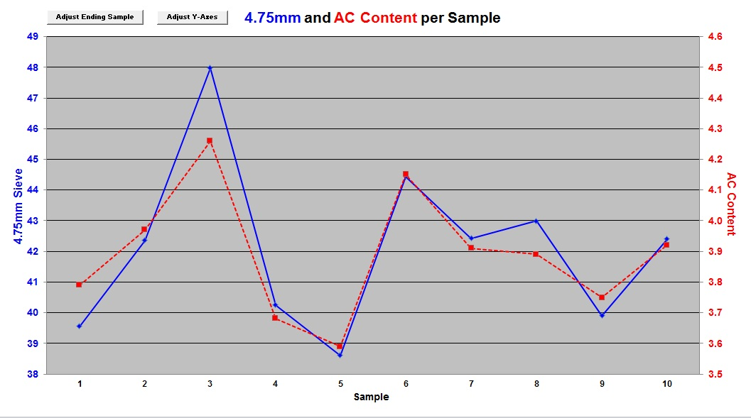
Segregated Mix
Notes:
We don’t have asphalt plants that add asphalt relative to gradation variability.
This graph shows 10 samples.
For each sample of the 25mm NMAS mix, the % passing the 4.75mm sieve is plotted relative to the left Y-axis, and the corresponding AC content is plotted relative to the right Y-axis.
A good rule of thumb for 25mm and 19mm NMAS mixes is a 1% change in the % passing the 4.75mm sieve is = a 0.1% change in measured AC content.
Unless you increase or decrease the % passing the 4.75mm sieve a given whole percentage AND have a corresponding increase or decrease in the AC content in an equal number of tenths of a percent, these two lines should NEVER track!
When they do, we are dealing with a segregated sample.
Segregated samples NEVER represent the mix that was produced.
Segregated samples ALWAYS have different volumetric results than we should have, had the sample been representative.
Identifying the problem is easy.
Correcting it can be challenging.

Slide 10
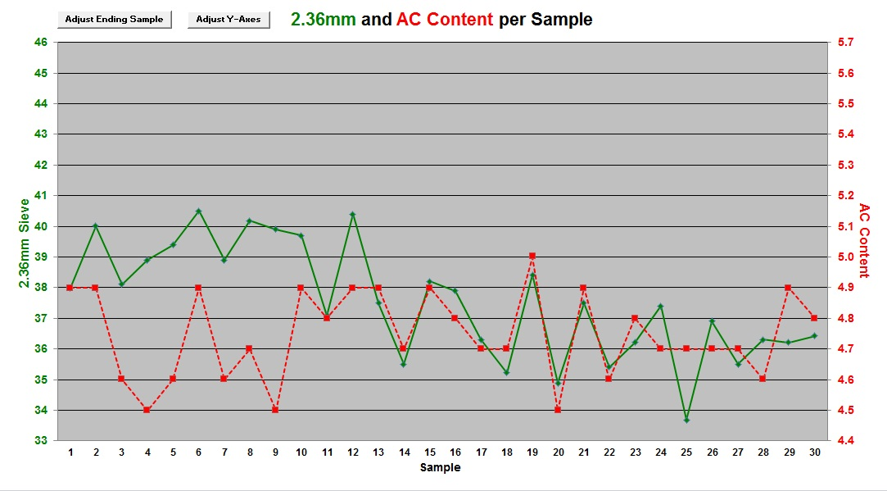
Segregated Mix
Notes:
This is an example of a 12.5mm NMAS coarse-graded mix.
Here we’re plotting the 2.36mm sieve and corresponding AC content.
Once again, you can see the trend with several samples where gradation and AC content track.

Slide 11
Non-Segregated Mix
Notes:
This is the same 12.5mm NMAS C-G mix data, showing samples with expected results.
Gradation will vary.
AC content should be very consistent, like it is for those four samples in a row.

Slide 12
Production QC
Plant Scheduling:
  Number of mixes & switchovers
  Mix verification prior to project start
Clearly Identify:
  Stockpiles (virgin and recycle)
  AC storage tanks
Stockpile Management:
  Build them right
  Prevent intermingling
  Load out of them right
  Use as many cold feeds as possible
  Identify Cold Feeds
Notes:
I mentioned earlier that EVERYONE plays a role in QC.
That includes plant managers, plant operators, loader operators, plant laborers, etc.
We have plants that often produce 6-8 mixes in a single day.
We don’t always produce all the tons needed for a single mix, before we switch over to producing another mix.
We always try to produce and test any mix before the actual initial startup of that mix.
It’s cheaper to produce it, sample it, test it and recycle it, than it is to remove and replace it from the project.
Are your individual materials clearly identified?
Have you ever had the wrong material placed where it shouldn’t have been?
Did you always catch it?
Is your plant manager and loader operator on the same page as to how stockpiles are to be constructed?
Does your loader operator ever scoop up a bucket full of aggregate and head to the cold feed instead of pushing the truck dumped aggregate onto the stockpile?
Are you feeding more than 25-30% of any given aggregate (virgin or recycle) through a single CF when there is another CF empty or not being used?
The plants where we produce 6-8 mixes a day have 12 virgin aggregate CF’s and 3 recycle CF’s, not so we can split a given aggregate into 2 CF’s instead of 1, but rather so we don’t have to empty a CF before we switch over…
Are your CF’s labeled so the end loader operator sees what material is supposed to go into that CF as they are approaching the CF?
What if was and it prevented a mistake?

Slide 13
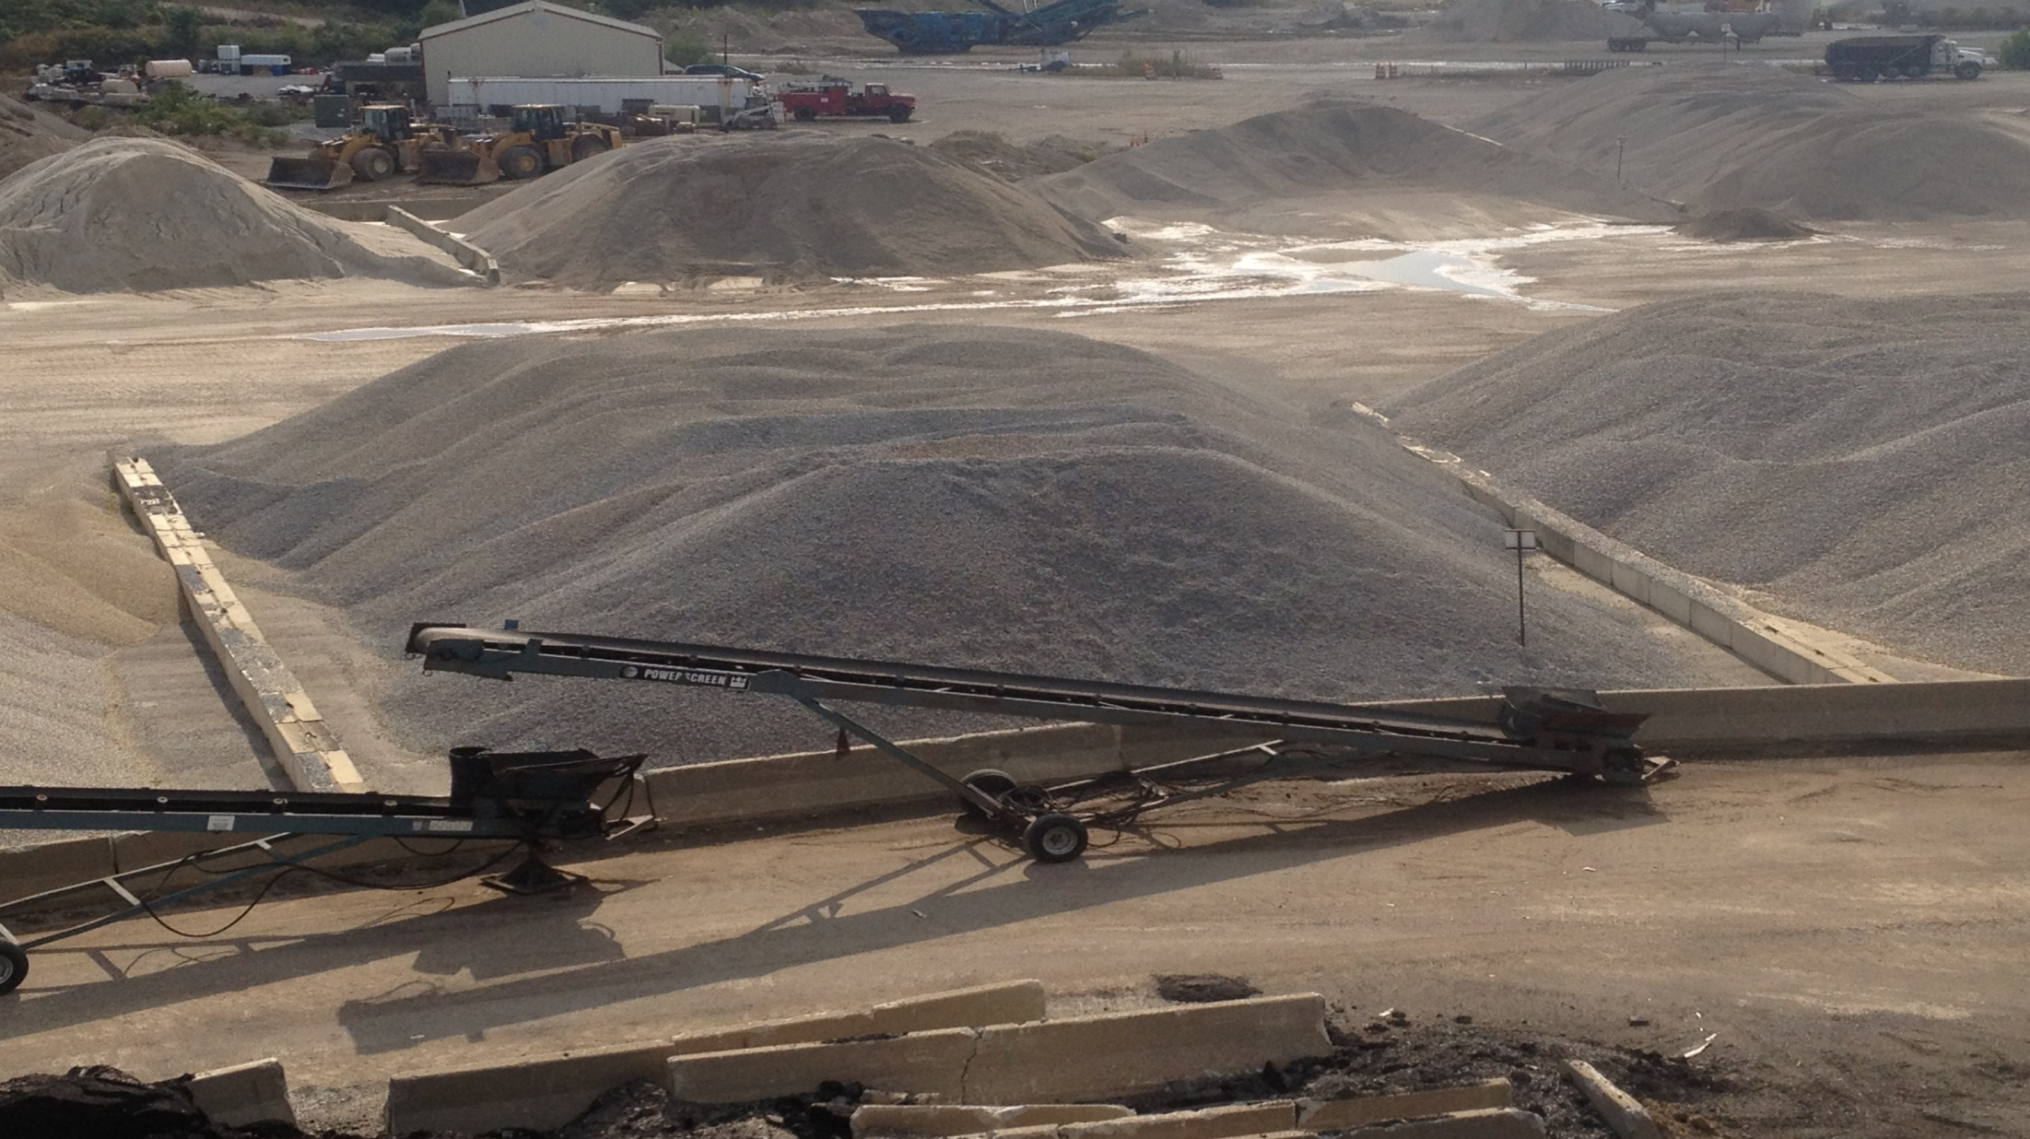
Notes:
Do you have stockpiles with barriers on three sides to prevent intermingling?
How can we load out of this stockpile in a manner perpendicular to the way we built it?
How can we test the most recently received material BEFORE we need to use it?

Slide 14
Production QC – Plant Calibration
Do it accurately and often
Cold feeds
AC/Binder
Additives
Multiple Rates:
  Low, Medium and High
Scales used to measure any of the above
Notes:
Are you calibrating the plant the same way you did 5 years ago?
What tools do we have today, to better understand how to improve the consistency of the mix we make?
At the plant, no one plays a bigger role in quality of the product than the plant operator. They often see fluctuations or changes BEFORE our QC results indicate something’s wrong.
Often, the plant operator knows something needs repaired, but they don’t have the time or authority to address the issue.
Are you calibrating your materials at a single rate or multiple rates?
If you’re calibrating at multiple rates, are you assuming a linear relationship exists?
Does moisture content play a role in how material comes out of a CF?
Is your moisture content of each aggregate and recycle product accurate?
Are your scales calibrated as accurately as possible and checked regularly?

Slide 15

Production QC – Plant Operation
Production rate
Temperature consistency
Use and level of silos or surge bins
Mix segregation:
  Are there locations where it is occurring?
  How can they be fixed?
  Impacts truck and plate samples!
Maintenance:
  Regularly scheduled items
  If it’s broke, fix it!
Notes:
Does production rate impact the quality of your mix?
Is it important how production rate is ramped up or ramped down?
Is mix temperature correct and consistent?
What range in production temperature is acceptable?
How significantly does it impact asphalt absorption?
Is your plant equipped with a variable frequency drive on the drum and the drag slat?
Are your batchers working correctly?
Is it pretty much full when the batch is dropped?
Do the gates close at the same time and close completely before the batcher is empty?
The mix level in a silo generally affects the consistency of the product it drops.
Does your plant operator have a favorite silo?
Maintenance…when isn’t there something that needs to be adjusted or fixed at an asphalt plant?

Slide 16
Production QC
It’s not just mix testing!
Inspection, Analysis and Action:
  Action occurs before sampling or before testing
  We react too often – we must be proactive
  Don’t assume the owner’s minimal requirements will suffice
QC personnel seldom have time to test and oversee the process
QC Managers play a vital role
Notes:
We have to get past the idea that QC is just mix testing.
The more proactive we are, the fewer surprises we’ll have when we test the mix to verify the quality of the product produced.
Testing consumes most QC technicians, so someone has to oversee the QC process and interpret the test results.
QC Managers play a vital role.

Slide 17
Placement QC – Misperception
It’s not just density and smoothness testing!
  Test results may predict pay, but…
  For unacceptable results, what’s the next step?
Many Field QC techs are overwhelmed!
  Lots of locations to test
  Often utilized for NON-QC tasks
  Sometimes undertrained
Someone has to look at the BIG picture……
Notes:
I often work with folks on the road, that take the approach of setting the gauge down, pressing a button, and simply recording the result, without giving any consideration as to whether or not the result is representative and what it means.
On the other hand, they may have lots of experience and valuable ideas to improve the density and/or smoothness on the road, but folks have not allowed them to contribute in the past, so they’ve just given up.
Does the person you have running density and/or smoothness tests have other, NON-QC responsibilities?
Has anyone ever spent the time to teach them how to operate the equipment safely and effectively, and how everything else in the operation plays a role in the result achieved?
Like lab QC technicians, field QC technicians are often consumed by testing, along with other responsibilities, so someone has to interpret the results.

Slide 18
Placement QC
Truck Dump Personnel – Backing Up and Unloading Trucks:
  Safely, Timely and Efficiently
  Communicate with truck driver, MTD and/or paver operator
  Impacts paver operation, mat consistency & flow of paving train
Screed Personnel:
  Address mat imperfections
  Strive for consistent texture and uniform density
Lute and Shoveling Personnel:
  Do they improve imperfections?
  Involvement in plate sampling?
Notes:
There are many things on the road that affect the quality of the final product.
With this and the next few slides, I’m going to point out some of the main points to consider.
I hope your company takes safety very seriously.
No one in the paving operation is more at risk than the truck dump person.
They must work safely, timely and efficiently when dumping trucks.
They must clearly communicate with the truck driver, MTD and/or paver operator.
The flow of the mix delivery process impacts the paver operation, mat placement consistency and resulting flow of the paving train.
Screed personnel must have the knowledge to adjust the screed in order to address mat imperfections. They must strive to achieve a consistent mat texture and uniform density.
Lute and Shoveling personnel play an important role as well.
Do they improve imperfections or make them worse?
Folks that are very good with a lute make it look easy, but it isn’t.
Who’s involved with taking your plate samples and do they know what’s at stake?

Slide 19
Placement QC – Paver Operation
Good working order?
Slope and grade?
Speed:
  Consistent?
  Match production rate?
  Delivery rate?
  Keep rollers in sight!
Screed:
  Uniform mat?
  Extensions set properly?
  Turning 90% of time?
  Mix at mid-depth?
  Tunnel and auger extensions?
Notes:
Is your paver in good working order?
Are there hydraulic oil or fuel leaks?
Is the grade control system working properly?
Is the paving speed consistent?
Is it set to match the plant production rate?
Is the delivery rate uniform?
Does your paver operator ever look back?
Is the screed laying a uniform mat or is the screed warped?
Are extensions set properly?
Are the augers turning 90% of the time and at a reasonable rate?
Is the mix at the mid-depth of the auger?
Are tunnel and auger extensions being used if needed?

Slide 20
Placement QC – Compaction
Rollers = Placement rate?
Is each one operating properly?
Operator familiar with equipment?
  Amplitude & frequency settings
  Water in drums
  Water spray system
  Tire pressure
Rolling Pattern:
  Number of passes?
  Pattern layout?
  Speed?
  Pattern length?
  Compaction temperature range for roller position?
  Directly impacts density and smoothness
Notes:
Are there enough rollers on the job to meet or exceed density requirements at the rate you want to place the mix?
Are they the right rollers for the mix being placed?
Is each roller working properly?
Way too often, folks don’t take the time to verify the settings for frequency and amplitude.
Sometimes, no one knows where to change the amplitude.
Does anyone have a reed tachometer to check the vibratory rollers?
Who establishes the rolling patterns?
Are your roller operators willing to listen and take direction?
Are your personnel willing to listen to the roller operator’s ideas of how to better obtain density and smoothness?
Long rolling patterns reduce bumps but can result in excessive temperature differentials between the front and back of the rolling pattern.
How hard do your folks strive to determine the optimum mix temperature in a given rolling zone – breakdown, intermediate and finish?
All of these things, and more, have a direct impact on the density and smoothness achieved.

Slide 21
Placement QC
There are many other items to pay attention to, such as:
  Base conditions – temp, smoothness, stiffness, texture
  Ambient conditions – air temp, sunlight, wind
  Prime / Tack – type, amount, uniformity of application, adequate cure time
  Mat thickness – available compaction time
Is anyone making time to watch these QC items?
Notes:
We could go on and on with numerous things that each play a role in the quality of the final product on the road.
The bottom line is, who’s responsible for looking at them?
Most are way too busy to take the time.
So, is someone, anyone, making the time?
They are all QC items!

Slide 22
Placement QC – Sampling/Testing
Mix samples:
  Take them correctly and consistently
  Identify them clearly and get them sent in
Density – Gauge:
  Is it working, and being used properly and frequently?
  Has it been calibrated to this mix, on this job?
Density – Cores:
  Use the right equipment, remove them carefully!
  Identify clearly and get them sent in
Smoothness:
  Mat thickness, mat temperature, etc.
Notes:
There are so many things that go into making a quality product long before we get to the point of sampling and testing the mix or compacted mat.
But just like the plant, way too often, we’re focused on these samples rather than what’s happening in the operation before we take a sample, that impacts the quality of the sample itself.
Are your truck samples representative of the mix the plant produced?
If you’re taking loose mix samples off the road, are they being taken correctly?
Who’s responsible? Have they been trained?
Have a plan to transport them to the required location.
How accurate is your non-destructive gauge?
Has it been calibrated to this mix, on this job?
What if the underlying layer changes?
Are your cores being removed with screwdrivers?
Do you have a plan to get them to the required location?
Who’s checking smoothness and looking at the various points in the placement operation that impacts these results?
What role does mat thickness and temperature, as well as consistency of each, play in density and smoothness?
What role does loose thickness on the confined side of the longitudinal joint and variability of that thickness, play in density achieved on the confined side?

Slide 23
Paver Screed
Obtain density readings every 1’ across uncompacted mat and test behind rollers to identify density variability across mat before and after compaction
Notes:
This is something we’ve been trying to get done at least a couple times each day.
Make it a practice to determine the density of the uncompacted mat behind the paver screed every 1 foot transversely across the mat.
The “actual” density result isn’t as important as the range in density.
We strive to keep that range at 1.5% or less.
Don’t hesitate to check known points of density concern, such as the center of the screed, edges of the flight chains, auger bearing pedestals, and screed extensions.
Segregation can occur on the bottom side of the mat and not be visible from the top.
Ever wonder if it really matters when trucks pull away and dump mix on the grade, that cools and gets run over before the paver lays the mat over it?
If transverse density variability exists behind the screed, it will be exist behind the finish roller.
Does your screed person or paver maintenance person know how to adjust the screed to improve density consistency across the mat?
If you have extensions that result in lower density than the main screed, are the extensions set to place the loose mix slightly thicker than the main screed so there is an adequate amount of material to compact?
You can’t roll transverse density variability out of a mat, but you can roll it in.
Who’s looking closely at the placement location of each roller pass?
Does each of your roller operators understand the importance of what they do?
Are your rollers equipped with a pass mapping system?
What if you’re dealing with night paving?

Slide 24
Paving Direction
25’
Obtain density readings every 25’ through roller pattern overlap to identify density variability
25’
X Feet
Approximate center of rolling pattern overlap
25’
25’
Notes:
We’re also trying to check a few locations each day, where breakdown roller patterns overlap.
We locate the middle of the overlap, choose a transverse location to test and then test each direction from that point at the same transverse offset.
Is density higher at the center of the overlap?
Is it lower?
Is density as uniform as we can possibly make it?
Where will the next randomly located density core fall?

Slide 25

In The Past…
Quality Control
QC Manager
Plant
Road
Notes:
This is what I refer to as the Bermuda Triangle…
When a problem occurs, each group points towards the other two as the cause!
But ALL three groups are on the same TEAM and ALL three need to work together to solve problems when they arise.
Better yet, they need to work as a TEAM to prevent problems from occurring in the first place.
In order to achieve that, each person on the TEAM needs to believe they play a role in QC and they need to know what that role is.
The person that is KEY to forming and maintaining communication of the TEAM is the QC Manager.
In order to do that, the QC Manager needs to have a good understanding of each of the three areas AND be involved in each of them.

Slide 26
Functioning as a TEAM!
Quality Control
Production
Placement
Clarify QC and Everyone’s Role
Train them, Enable them, and Support them
Notes:
QC is much more than mix, density and smoothness testing.
Does your TEAM understand this?
Clarify QC and everyone’s role in it.
It requires a total TEAM effort to be successful.
Train them, Enable them, and Support them!

Slide 27
Thank You!
Bill Pine
QC Director of Asphalt Technology
Heritage Construction & Materials
billp@thgrp.com
(217) 840-4173

